Slide 1


Detecting Spam Reviews on Vietnamese E-commerce Websites
Please follow the link for the video presentation:
https://www.youtube.com/watch?v=zdy8yONdQU8

Slide 2
Tables of contents
Step 1
Step 2
Step 3
Step 4
Step 5
Step 6
Data cleaning
Exploratory data analysis (EDA)
Data preprocessing
Model building & Evaluation
Compare
Deploy

Slide 3
Data cleaning
Purpose: Data cleaning helps to improve the accuracy and quality of the data used in the modeling process
Drop Rating, SpamLabel Columns -> focus on spam/ ham classification.
Encoder `Label` Column
Check If the data has any empty or dupliacte values.
Then, drop them.

Slide 4
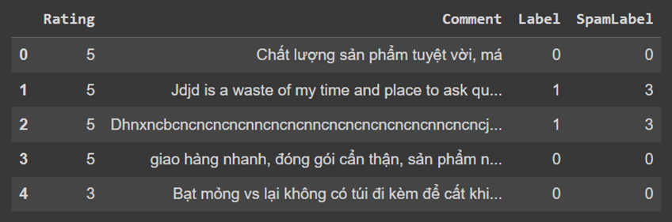
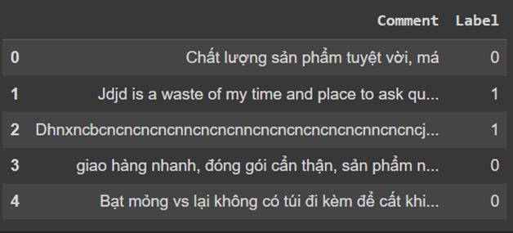
Data cleaning
Before
After

Slide 5

Exploratory Data Analysis (EDA)
Purpose: (EDA) allows to gain a deeper understanding of the data, identify patterns and trends, and develop insights that can be used to inform downstream modeling tasks.
Count the number of characters, the number of words and the number of sentences
Provide a comprehensive overview of the data being analyzed.
This helps identify patterns in the data, compare different data sets, and uncover relationships between variables.
Allows us to get an idea of the overall complexity of the data, which can be helpful in determining how best to present it.

Slide 6
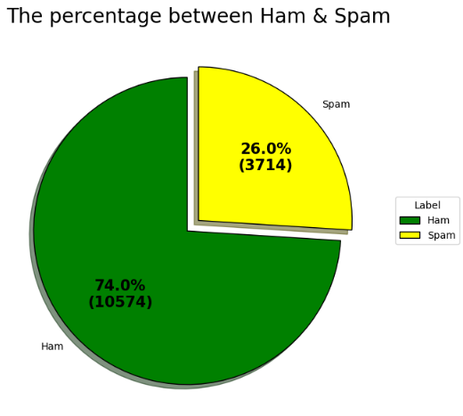
EDA

Slide 7
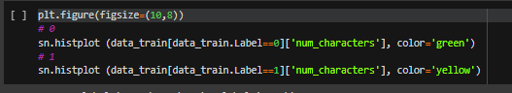
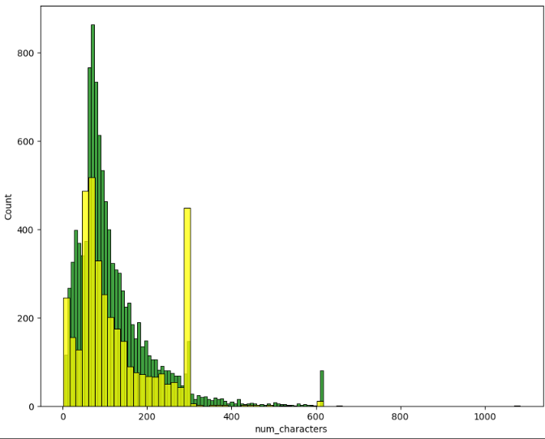
EDA
The number of Characters
Green columns : No-Spam
Yellow columns: Spam

Slide 8
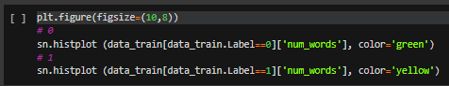
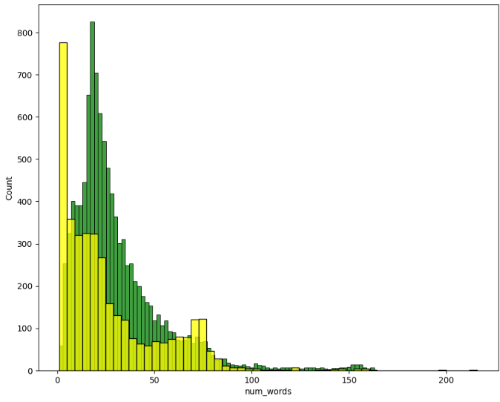
EDA
The number of Words
Green columns : No-Spam
Yellow columns: Spam

Slide 9
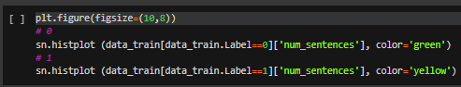
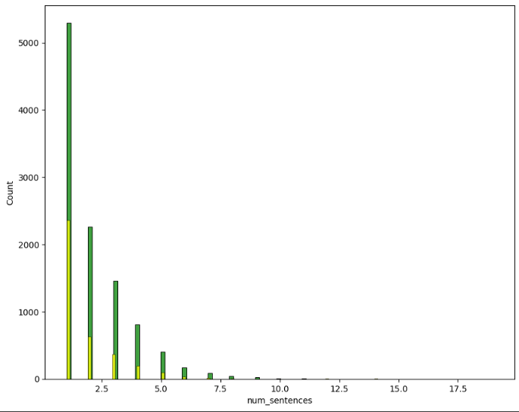
EDA
The number of Sentences
Green columns : No-Spam
Yellow columns: Spam

Slide 10
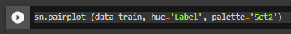
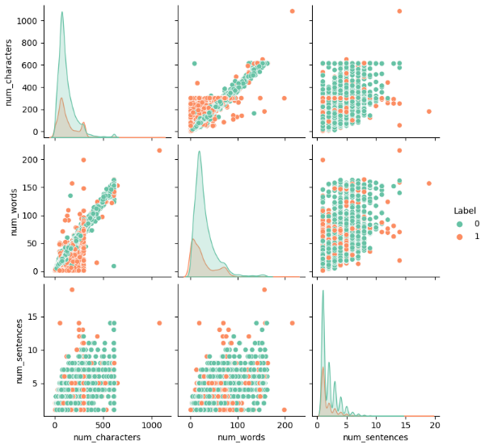
EDA
Pairplot
If the column on the x-axis has the same name as the column on the y-axis, a bar chart will be returned and the different columns combined will give us a scatter chart to see the dispersion of the data in the dataset.

Slide 11
EDA
Pairplot
For example:
When you look at the graph of the second line, the first column between num_characters and num_words, looking at the blue dots, you can see that this is linear data, meaning that as the number of characters increases, the number of words also increases.

Slide 12
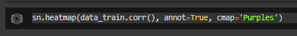
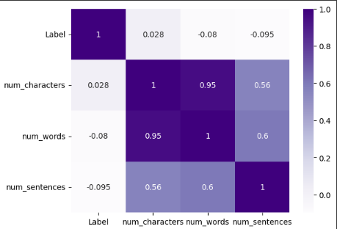
EDA
Heatmap
In machine learning, we often use heatmap charts to look at data correlation between columns.
Cmap parameter is used to change the histogram color, and annot = True to display the correlation coefficient

Slide 13
Data Preprocessing
Marketing Plan | January 2020
Lower case
Tokenization
Remove Special Characters
Removing stopwords and punctuation
Drop ""
JANUARY 2020

Slide 14
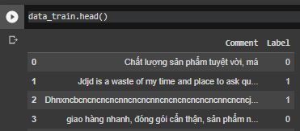
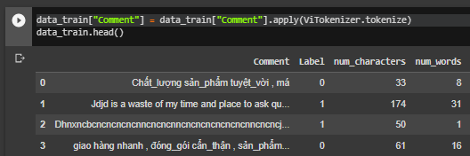
Tokenization
Before
Words with 2 syllables
For example: hiệu quả, chất lượng
--> Hiệu_quả, chất_lượng
To keep the meaning of the word
After

Slide 15
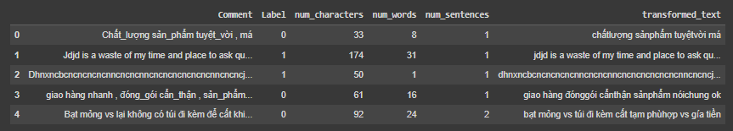
Lower case, Stopwords, Special Characters, Punctuation, Drop ""
the transformed_text column is the data after being processed

Slide 16
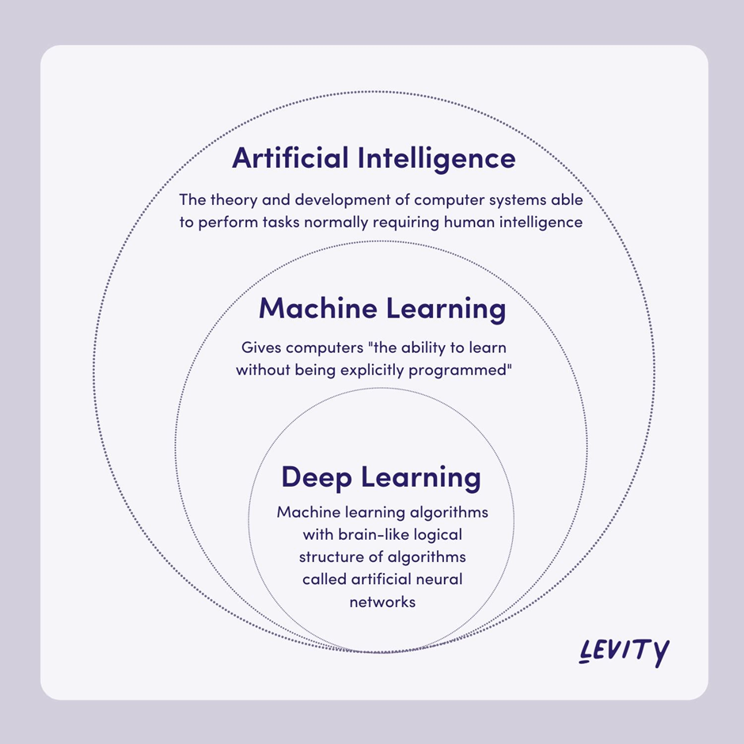
Model building & Evaluation
Model building and Evaluation involves the creation and testing of machine learning models to perform tasks such as sentiment analysis, language translation, text classification, and more.
11

Slide 17
Clasic Machine Leaning Models
Marketing Plan | January 2020
· SVC
· KNeighborsClassifier
· MultinomialNB
· GaussianNB
· BernoulliNB
· DecisionTreeClassifier
· LogisticRegression
· RandomForestClassifier
· AdaBoostClassifier
· BaggingClassifier
· ExtraTreesClassifier
· GradientBoostingClassifier
· XGBClassifier
06
JANUARY 2020

Slide 18
Compare CountVectorizer & TF-IDF
CountVectorizer
Stands for "term frequency-inverse document frequency".
Accounts for the importance of each word in the text.
Can be useful for tasks such as information retrieval or document similarity, where more important words can be used to match documents or identify relevant information.
Generates a bag-of-words representation, which simply counts the frequency of each word in the text.
Does not take into account the importance of each word in the text, and treats all words equally.
Can be useful for tasks such as text classification or clustering, where the frequency of certain words may be indicative of the text's category or topic.
04
TF-IDF

Slide 19
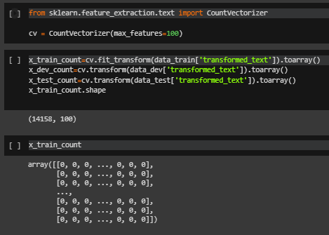
CountVectorizer
Convert a collection of text documents to a matrix of token counts.
11

Slide 20
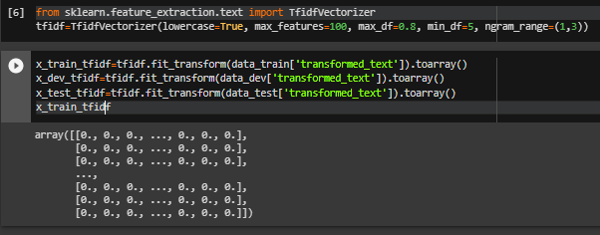
TfidfVectorizer
Convert a collection of raw documents to a matrix of TF-IDF features.
11

Slide 21
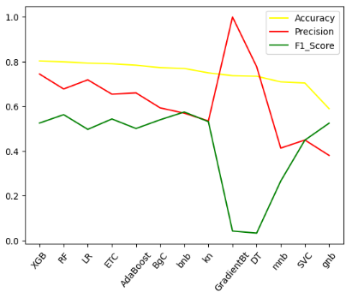
CountVectorizer
This chart shows the Accuracy, F1-Score, Precision of each Classic ML Models on data_dev
11

Slide 22
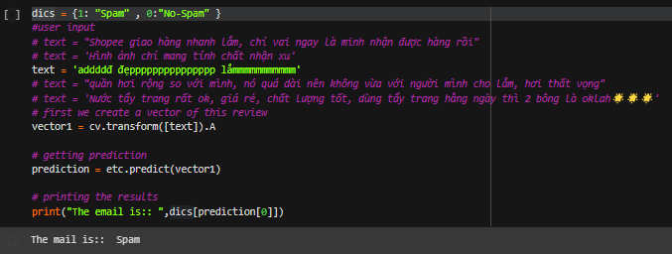
CountVectorizer
Model testing
11

Slide 23
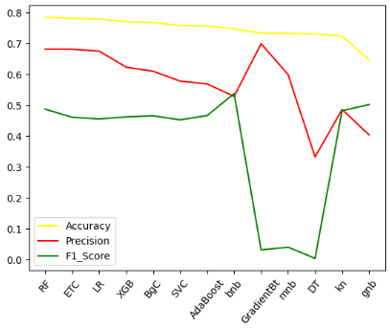
TfidfVectorizer
This chart shows the Accuracy, F1-Score, Precision of each Classic ML Models on data_dev
11

Slide 24
Deep
Learning
LSTM
CNN
Hyperparameter Tunning
Marketing Plan | January 2020
ANN
RNN

Slide 25
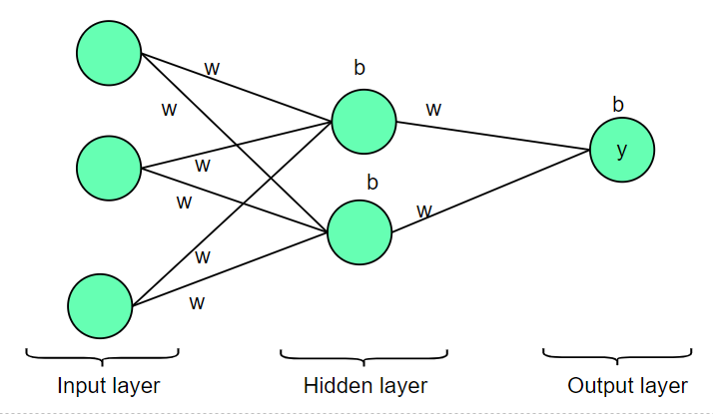
(ANNs)
ARTIFICIAL NEURAL NETWORK

Slide 26
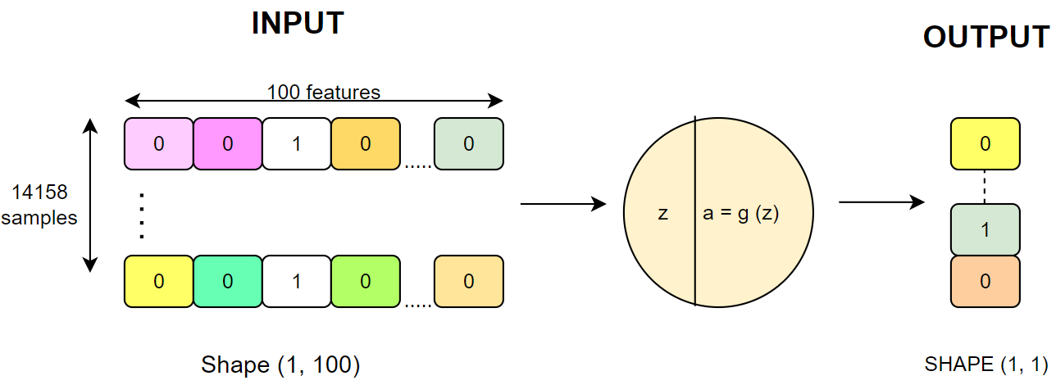

Slide 27
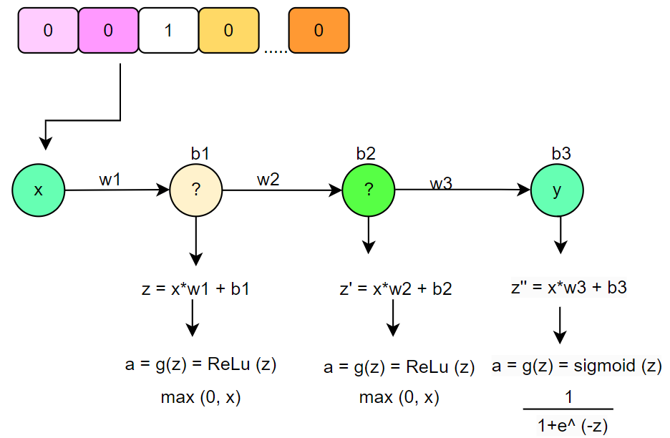
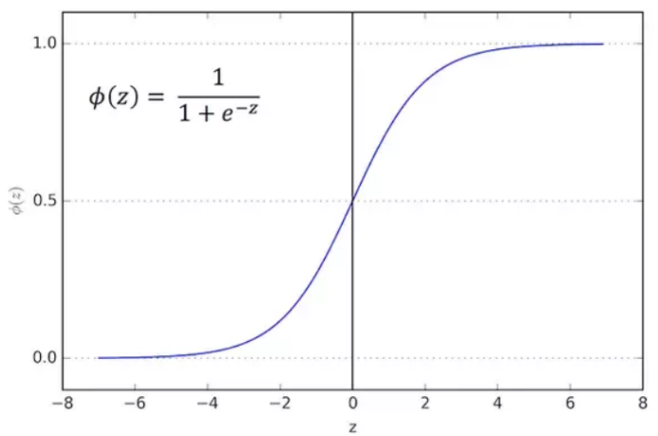
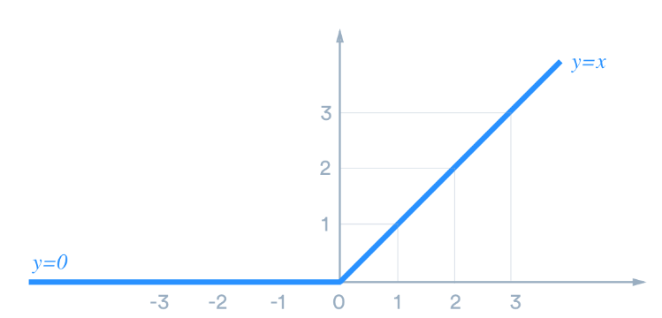
We can use some other activation functions like ReLu, Elu, softmax... but for the Binary classification problem, in the output layer we usually use the sigmoid function.
Sigmoid
ReLu
To reduce the training time as well as the computational cost, we should use the ReLu function
Continuous function, taking real values in the interval (0,1).
Function with derivative at every point (to apply gradient descent).

Slide 28
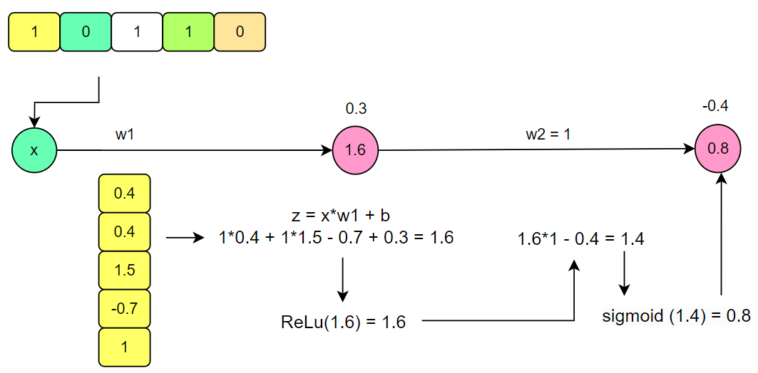

Slide 29

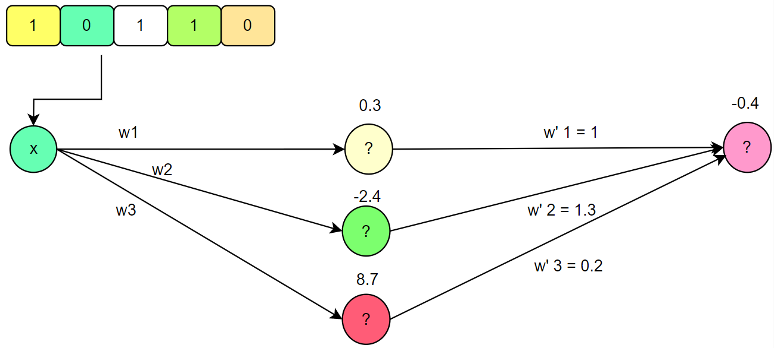
What happens if there is more than 1 unit ?

Slide 30
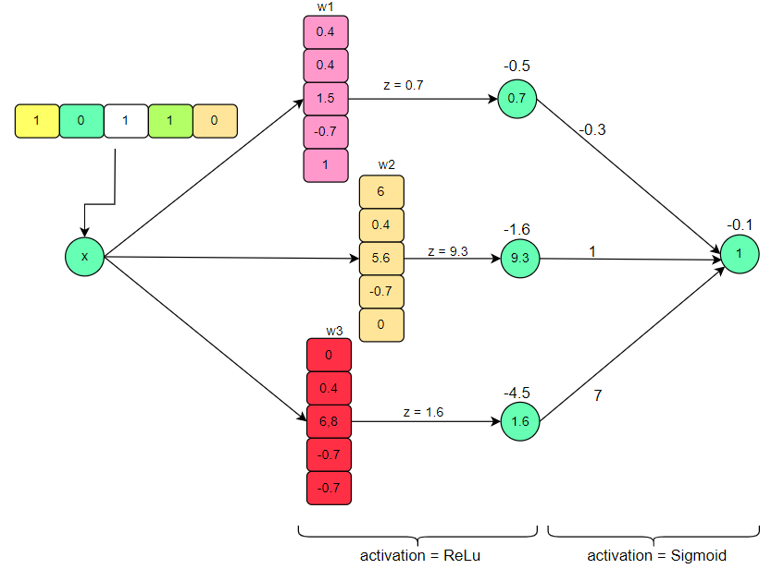
PARAM
(5 * 3) + 3 + 3 + 1 = 22

Slide 31
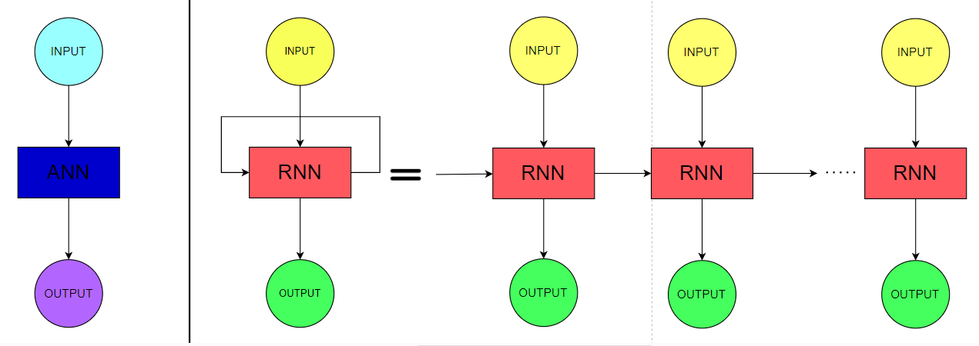
(RNNs) Recurrent Neural Network
RNN is a supervised learning technique that mimics the short-term memory.
The concept behind RNN is that it remembers the knowledge it learned from the previous observations.
Then, it uses this knowledge as it moves forward. In the case of RNN, the hidden layers do not just produce outputs, but it also feedbacks itself as displayed in this picture.
The RNN utilizes the power of short-term memory in processing the data

Slide 32
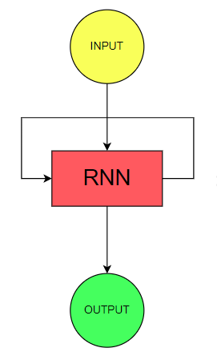
The input layer processes the initial input and passes it to the middle layer RNN. The middle layer consists of multiple hidden layers, each with its activation functions, weights, and biases.
These parameters are standardized across the hidden layer so that instead of creating multiple hidden layers, it will create one and loop it over.

Slide 33
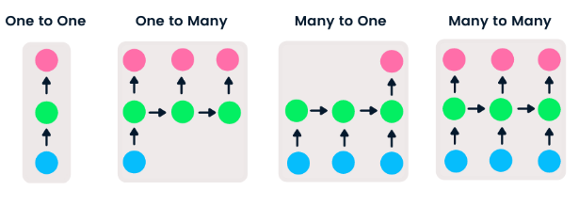

There are four types of RNN based on different lengths of inputs and outputs.
One-to-one is a simple neural network. It is commonly used for machine learning problems that have a single input and output.
One-to-many has a single input and multiple outputs. This is used for generating image captions.
Many-to-one takes a sequence of multiple inputs and predicts a single output. It is popular in sentiment classification, where the input is text and the output is a category.
Many-to-many takes multiple inputs and outputs. The most common application is machine translation.

Slide 34
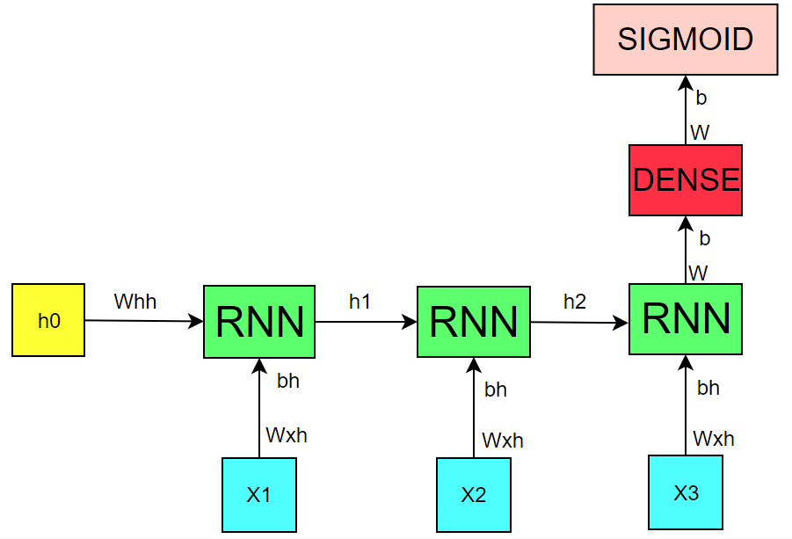

Slide 35
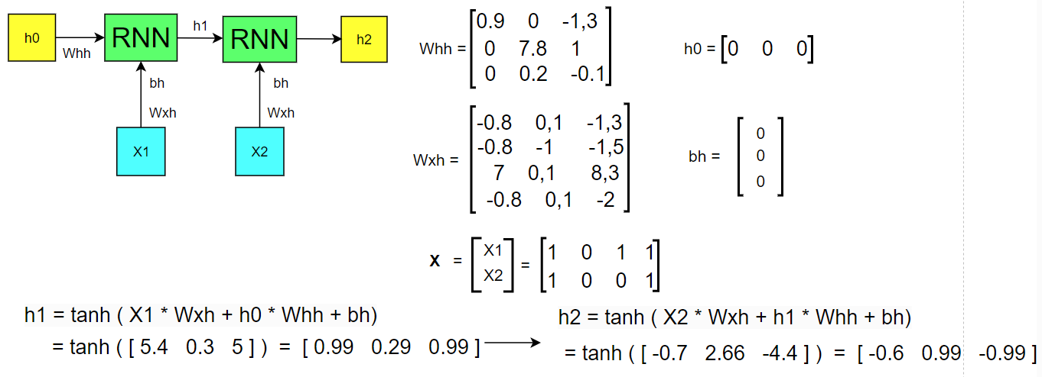

Slide 36
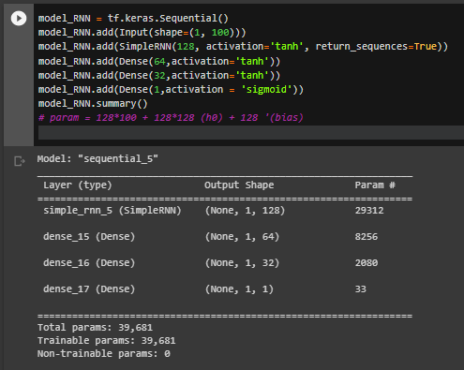
Input shape (1, 100) --> Wxh (100, 128)
--> h1 (1, 128)
So: h0 : shape (1, 128) and
Whh ( units, units) ~ (128, 128)
PARAM
SimpleRNN: 100 * 128 + 128 * 128 + 128 = 29312
Dense: 128 * 64 +64 = 8256
similar to the remaining dense layers

Slide 37
Convolutional Neural Network Architecture
Back to Agenda Page

Slide 38

CNNs are a class of Deep Neural Networks that can recognize and classify particular features from images and are widely used for analyzing visual images. Their applications range from image and video recognition, image classification, medical image analysis, computer vision and natural language processing. CNN has contributed a lot in the field of computer vision and image analysis.
CNN is very useful as it minimises human effort by automatically detecting the features. For example, for apples and mangoes, it would automatically detect the distinct features of each class on its own.

Slide 39

The network is composed of the following components:
Convolution Layer (Conv): The goal of the Conv layer is to extract high-level features from the input raw information using filters (filters/kernels).
Pooling Layer - Pool: The pooling layer (POOL) is a downsampling operation (downsampling is the reduction of the sampling frequency), often used after the convolution layer, which helps to increase the spatial invariance and reduce the computational cost. math and training time but still retain important features
Fully Connected Layer (FC): The fully connected layer takes as input the flattened data, in which all neurons in the current layer will be connected to all other nodes. neurons in the previous layer

Slide 40
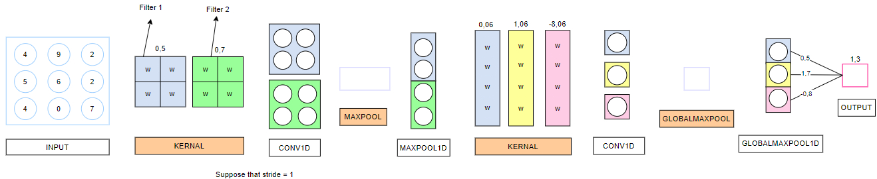
A basic CNN model can be described specifically as follows:
Convolutional neural network model with input as a feature matrix of size 3x3, convolutional layers, and an output, where w is the weight in the filters and b is the bias value of the filters that – for the convolutional component, w is the link weight and b is the bias of the computation unit – for the fully connected component.

Slide 41

Suppose we have a convolutional neural network with a structure like Figure below, where the weights and biases are initialized randomly, with the following data sample:
[[4 9 2],
[5 6 2],
[4 0 7]]
Sample data as a three-dimensional matrix is fed directly into the model

Slide 42
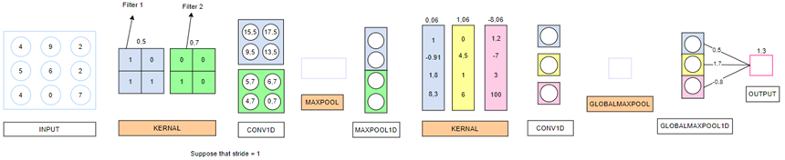
The output of a computational unit in a convolutional neural network is generalized by the following formula:
Output=X*W+b
Where, x is the value matrix of the feature to be extracted, w is the weight of the filter participating in the information extraction, and b is the bias value of that filter. From there, the value of the first convolutional layer with the first kernel is calculated as follows:
4 + 5 + 6 + 0.5 = 15.5
9 + 6 + 2 + 0.5 = 17.5
5 + 4 + 0.5 = 9.5
6 + 7 + 0.5 = 13.5
The value of the first convolutional layer with the second kernel is calculated similarly as follows:
5 + 0.7 = 5.7
6 + 0.7 = 6.7
4 + 0.7 = 4.7
0 + 0.7 = 0.7

Slide 43
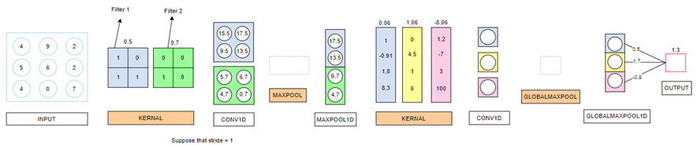
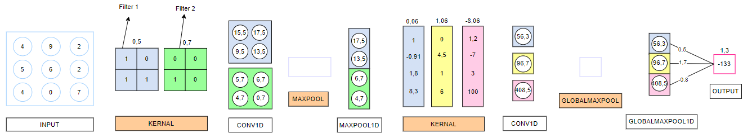
Through the MAXPOOL layer only the significant value is kept, so the result of the pooled layer includes only the maximum values of each previous convolution layer:
With the same convolution calculation and fully connected layer computation as mentioned in the DNN section, a complete convolution model is computed with the following values:

Slide 44
Add Company Name
LSTM Model

Slide 45
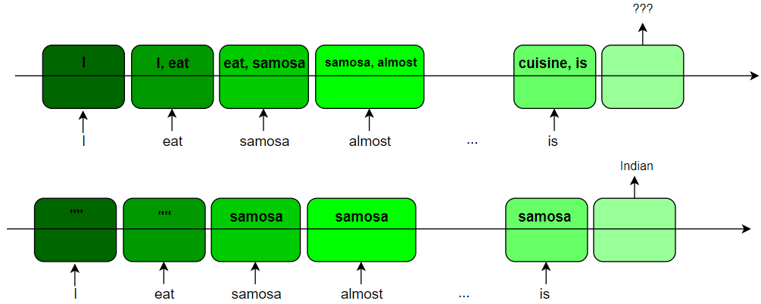
For example
I eat samosa almost everyday, it shouldn't be hard to guess that my favorite cuisine is ...
RNN
LSTM
LSTM has the ability to capture long-term dependencies by incorporating memory cells and gating mechanisms. This enables LSTMs to effectively store and retrieve relevant information from earlier parts of the input sequence, making them more capable of dealing with this problem

Slide 46
DEFINITION
LSTM is an improvement of RNN that allows learning long-term dependencies, which are limited in traditional recurrent neural networks.
The ability to retain information over long periods of time is an inherent feature of LSTM, and it does not require additional training to achieve long-term memory.
It has a sequential architecture similar to a standard RNN, but the modules have a different structure.
LSTM consists of four interacting neural network layers that work together in a unique way.

Slide 47
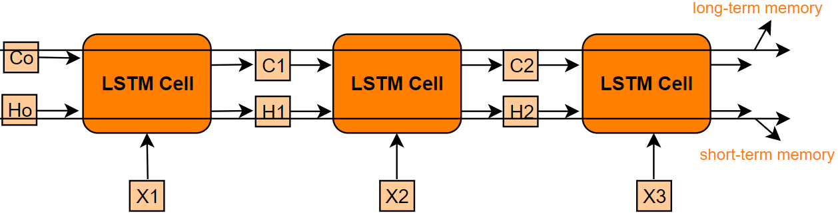
Comparision
States:
Simaliar to RNN: Hidden state Ht
Different from RNN: hidden state is broken into 2 states: cell state (called internal (main) memory where all info will be stored) và hidden state (used for computing the output)

Slide 48
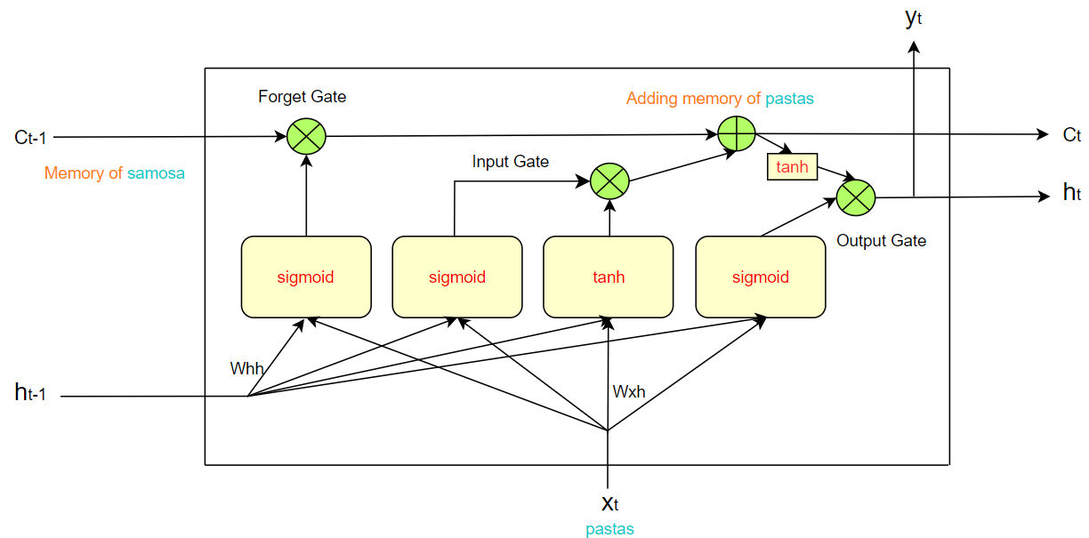
Structure

Slide 49
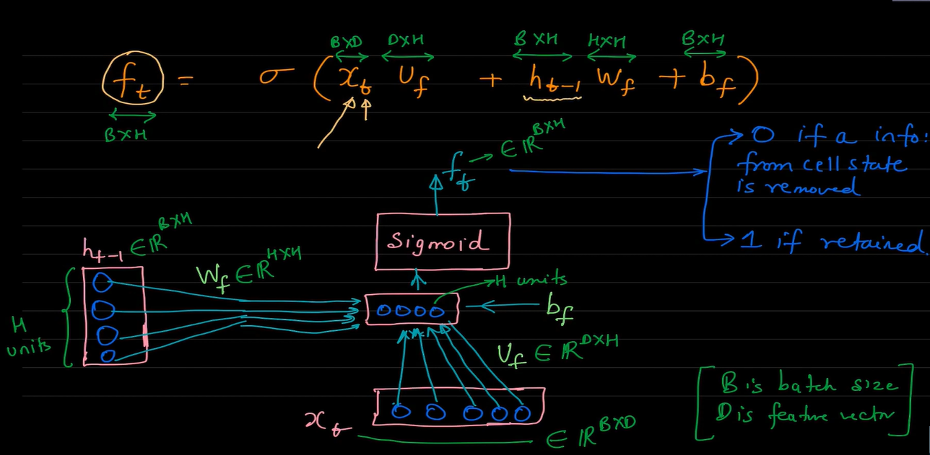
Forget Gate
Forget Gate: This gate decides what information should be thrown away or kept. Information from the previous hidden state and information from the current input is passed through the sigmoid function. Values come out between 0 and 1. The closer to 0 means to forget, and the closer to 1 means to keep.

Slide 50
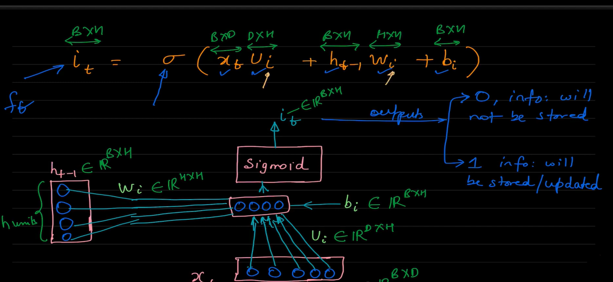
Input Gate
Input Gate: First, we pass the previous hidden state and current input into a sigmoid function. That decides which values will be updated by transforming the values to be between 0 and 1. 0 means not important, and 1 means important. We also pass the hidden state and current input into the tanh function to squish values between -1 and 1 to help regulate the network.

Slide 51
Example:
Mark is a good singer. He lives in California. Jacob is also a good singer.
⇒ The memory of Mark should be removed, and Jacob is the new subject.
We can see the subject has changed from Mark to Jacob

Slide 52
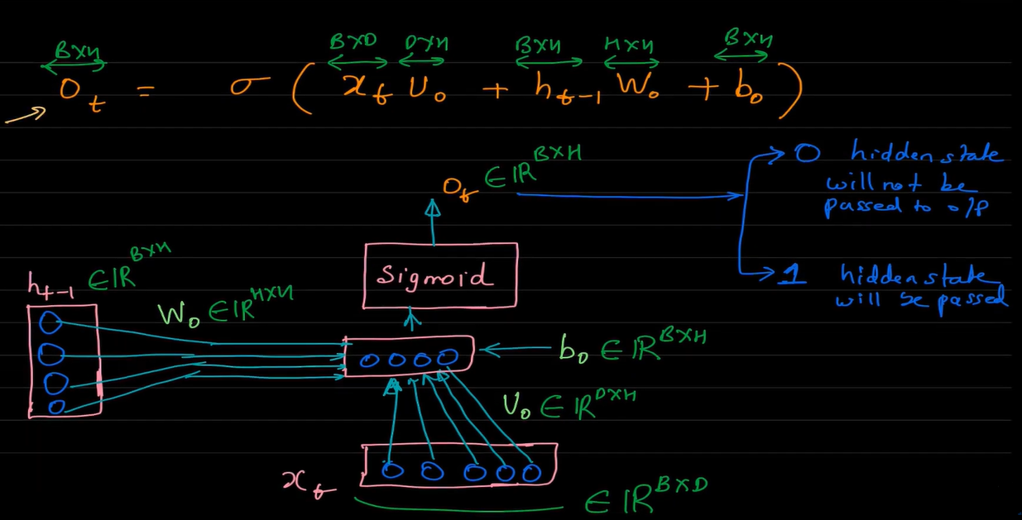
Output Gate
Consider the following sentence: Jacob debut album was a hug success. Congrate . . . ... =⇒ Jacob
Output Gate: The output gate decides what the next hidden state should be. Remember that the hidden state contains information on previous inputs. The hidden state is also used for predictions. First, we pass the previous hidden state and the current input into a sigmoid function. Then we pass the newly modified cell state to the tanh function. We multiply the tanh output with the sigmoid output to decide what information the hidden state should carry. The output is the hidden state. The new cell state and the new hidden is then carried over to the next time step.

Slide 53
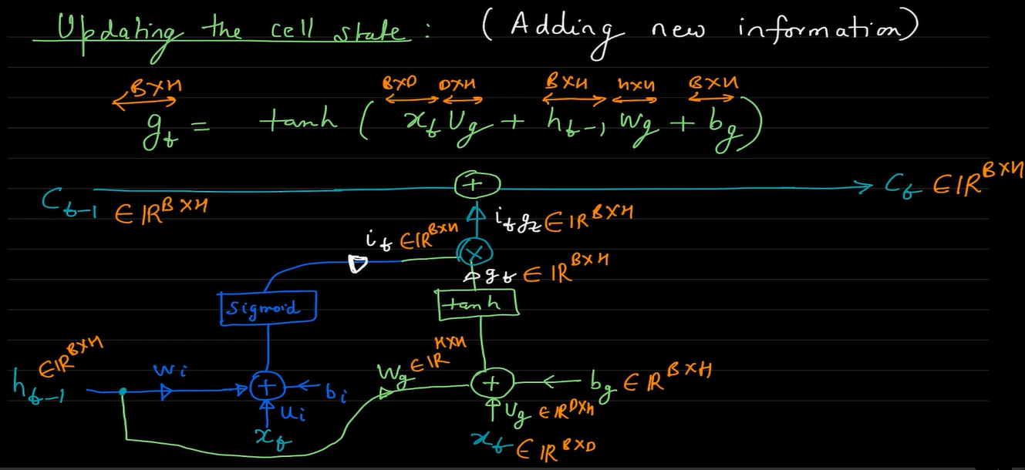

Slide 54
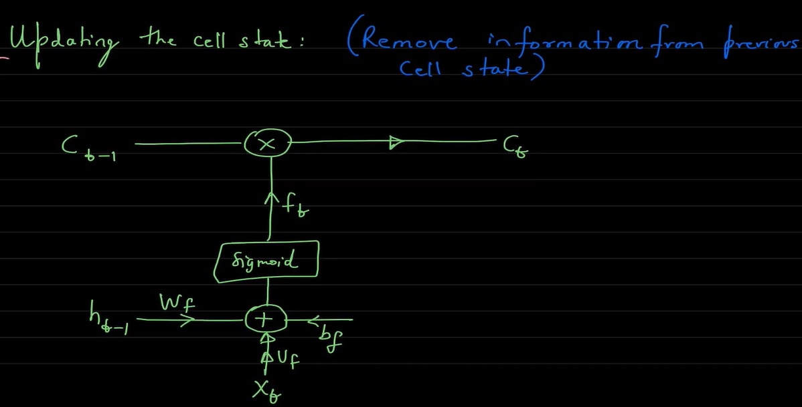

Slide 55
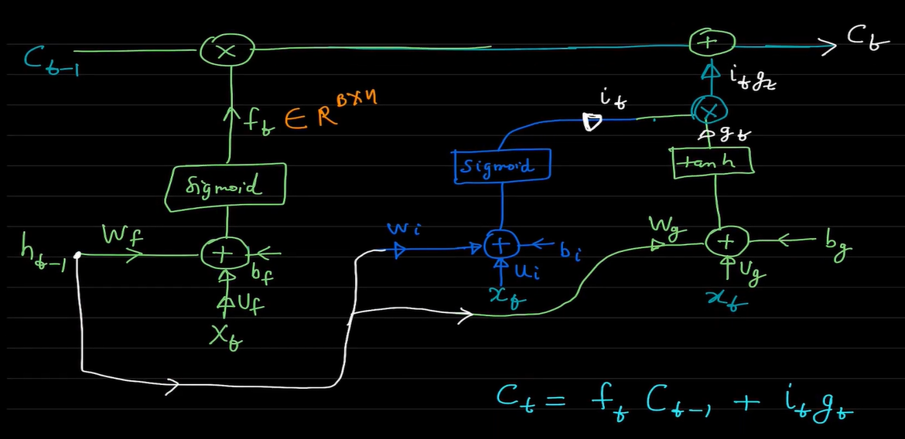
Ct

Slide 56
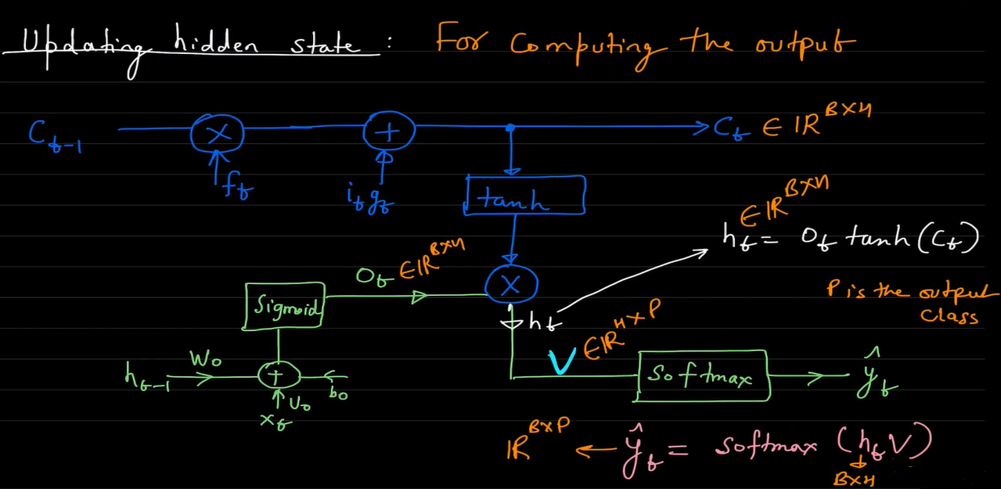

Slide 57


Slide 58


Slide 59


# param_Embedding = VOCAB_SIZE*300 = 18359*300 = 5507700
# param_LSTM_1 = (300*400 + 400 (bias) + 400*400 (Recurrent))*4 = 1121600
# param_LSTM_2 = (400*400 + 400 (bias) + 400*400 (Recurrent))*4 = 1281600

Slide 60
HYPERPARAMETER OPTIMIZER
by BT HUONG

Slide 61

Hyper-parameter refers to parameters that cannot be updated during the training of machine learning. They can be involved in building the structure of the model, such as the number of hidden layers and the activation function, or in determining the efficiency and accuracy of model training, such as the learning rate (LR) of stochastic gradient descent (SGD), batch size, the number of ebochs and optimizer
Parameter are learned through the training procedure.
Example : weight, bias

Slide 62



The hyperparameters are evaluated based on the losses of the model predictions, viz. the hyperparameters are set on the model, the model is trained on the data, and the performance of the model is evaluated based on the loss function.
These steps are followed iteratively to find the optimal set of hyperparameters. As said earlier we might or might not end up with a globally optimal solution.

Slide 63

With each different set of hyperparameters will give different results

Slide 64

The hyperparameters of deep learning models may need to be optimized

Slide 65

To find the best set of hyperparameters for a deep learning model, we can follow two approaches: manual tuning and automatic tuning.

Slide 66


Slide 67

KerasTuner
Keras Tuner is an open-source library developed by the Keras team. It provides tools for searching and tuning the hyperparameters of deep learning models, such as the network architecture, the number of layers, the number of computational units, the learning rate, etc.
The KerasTuner library enables the exploration of various hyperparameter configurations to find the best set of values. It automates the process of hyperparameter tuning and assists in determining the optimal hyperparameter values for a given deep learning model.

Slide 68
Choice method
Arguments
name: A string. the name of parameter. Must be unique for each HyperParameter instance in the search space.
values: A list of possible values. Values must be int, float, str, or bool. All values must be of the same type.
Float method
Arguments
name: A string. the name of parameter. Must be unique for each HyperParameter instance in the search space.
min_value: Float, the lower bound of the range.
max_value: Float, the upper bound of the range.
step: Optional float, the distance between two consecutive samples in the range. If left unspecified, it is possible to sample any value in the interval. If sampling="linear", it will be the minimum additive between two samples. If sampling="log", it will be the minimum multiplier between two samples.

Slide 69
Int method
Arguments
name: A string. the name of parameter. Must be unique for each HyperParameter instance in the search space.
min_value: Integer, the lower limit of range, inclusive.
max_value: Integer, the upper limit of range, inclusive.
step: Optional integer, the distance between two consecutive samples in the range. If left unspecified, it is possible to sample any integers in the interval. If sampling="linear", it will be the minimum additive between two samples.
.

Slide 70


Based on the results, the LSTM model consistently outperformed the other models in terms of Accuracy score and F1-Macro across all datasets.

Slide 71



Slide 72

COMPARE
Article of Luu Thanh Son and his team

Slide 73
References
[1] Van Dinh, C., Luu, S. T., & Nguyen, A. G. T. (2022, December). Detecting Spam Reviews on Vietnamese E-Commerce Websites. In Intelligent Information and Database Systems: 14th Asian Conference, ACIIDS 2022, Ho Chi Minh City, Vietnam, November 28–30, 2022, Proceedings, Part I (pp. 595-607). Cham: Springer International Publishing.
21] Othman, N. F., & Din, W. I. S. W. (2019). Youtube spam detection framework using naïve bayes and logistic regression. Indonesian Journal of Electrical Engineering and Computer Science, 14(3), 1508-1517.
[3] Chen, Y. (2015). Convolutional neural network for sentence classification (Master's thesis, University of Waterloo).
[4] Huynh, H. D., Do, H. T. T., Van Nguyen, K., & Nguyen, N. L. T. (2020). A simple and efficient ensemble classifier combining multiple neural network models on social media datasets in Vietnamese. arXiv preprint arXiv:2009.13060.

Slide 74
References
[5] scikit-learn.org. 2023. 6.2. Feature extraction — scikit-learn 1.2.2 documentation. [ONLINE] Available at: https://scikit-learn.org/stable/modules/feature_extraction.html#text-feature-extraction. [Accessed 11 April 2023].
[6] viblo.asia. 2023. Phân loại văn bản tự động bằng Machine Learning như thế nào?. [ONLINE] Available at: https://viblo.asia/p/phan-loai-van-ban-tu-dong-bang-machine-learning-nhu-the-nao-4P856Pa1ZY3.
[7] viblo.asia. 2023. Ứng dụng Machine Learning để phân loại spam SMS. [ONLINE] Available at: https://viblo.asia/p/ung-dung-machine-learning-de-phan-loai-spam-sms-07LKXwg85V4. [Accessed 11 April 2023].
[8] guendouz.wordpress.com. 2015. Implementation of TF-IDF in JAVA – Guendouz Mohamed. [ONLINE] Available at: https://guendouz.wordpress.com/2015/02/17/implementation-of-tf-idf-in-java/.
[9] caihuuthuc.wordpress.com. 2020. Precision, Recall và F1-score là gì? – Cái Hữu Thức's notes. [ONLINE] Available at: https://caihuuthuc.wordpress.com/2020/02/23/precision-recall-va-f1-score-la-gi/.
[

Slide 75
References
[10] Karim, M., & Rahman, R. M. (2013). Decision tree and naive bayes algorithm for classification and generation of actionable knowledge for direct marketing.
11] Rezaeinia, S. M., Ghodsi, A., & Rahmani, R. (2017). Improving the accuracy of pre-trained word embeddings for sentiment analysis. arXiv preprint arXiv:1711.08609.
[12] realpython.com. 2023. Practical Text Classification With Python and Keras – Real Python. [ONLINE] Available at: https://realpython.com/python-keras-text-classification/#convolutional-neural-networks-cnn.
[13] dennybritz.com. 2015. Recurrent Neural Networks Tutorial, Part 1 – Introduction to RNNs · Denny's Blog. [ONLINE] Available at: https://dennybritz.com/posts/wildml/recurrent-neural-networks-tutorial-part-1/.
[14] Othman, N. F., & Din, W. I. S. W. (2019). Youtube spam detection framework using naïve bayes and logistic regression. Indonesian Journal of Electrical Engineering and Computer Science, 14(3), 1508-1517.

Slide 76
References
[15] www.machinelearningnuggets.com. 2022. TensorFlow Recurrent Neural Networks (Complete guide with examples and code). [ONLINE] Available at: https://www.machinelearningnuggets.com/tensorflow-lstm/.
16] machinelearningmastery.com. 2022. Binary Classification Tutorial with the Keras Deep Learning Library - MachineLearningMastery.com. [ONLINE] Available at: https://machinelearningmastery.com/binary-classification-tutorial-with-the-keras-deep-learning-library/.
[17] www.machinelearningnuggets.com. 2022. TensorFlow Recurrent Neural Networks (Complete guide with examples and code). [ONLINE] Available at: https://www.machinelearningnuggets.com/tensorflow-lstm/.
[18] www.linkedin.com. 2023. Count Vectorizer vs TFIDF Vectorizer | Natural Language Processing. [ONLINE] Available at: https://www.linkedin.com/pulse/count-vectorizers-vs-tfidf-natural-language-processing-sheel-saket.
[19] Larabi-Marie-Sainte, S., Ghouzali, S., Saba, T., Aburahmah, L., & Almohaini, R. (2022). Improving spam email detection using deep recurrent neural network. Indonesian Journal of Electrical Engineering and Computer Science, 25(3), 1625-1633.

Slide 77
REFERENCES
[20] Liu, P., Qiu, X., & Huang, X. (2016). Recurrent neural network for text classification with multi-task learning. arXiv preprint arXiv:1605.05101.
[21] Yu, T., & Zhu, H. (2020). Hyper-parameter optimization: A review of algorithms and applications. arXiv preprint arXiv:2003.05689.
[22] Rogachev, A. F. (2021). Optimization of Artificial Neural Network Hyperparameters For Processing Retrospective Information. In CEUR Workshop Proceedings.
[23] O’Malley, T.: Hyperparameter tuning with Keras Tuner. https://blog.tensorflow.org/2020/01/hyperparameter-tuning-with-keras-tuner.html, last accessed 2020/10/21.
[24] https://www.analyticsvidhya.com/blog/2021/06/tuning-hyperparameters-of-an-artificial-neural-network-leveraging-keras-tuner/
[25] https://keras.io/api/keras_tuner/hyperparameters/

Slide 78
Work Asignment
Bùi Thị Hương

